Slide 1

Spotify songs popularity visualization and analysis
Simrik Rijal (300340875)
Sisir Ghimire Chettri (300340871)

Slide 2
Overview
Spotify tracks dataset from Kaggle which was collected from Spotify’s Web API (2022)
25 MB file size (CSV)
114,000 rows of data initially
76,962 rows after pre-processing
125 genres
1000s of songs
Audio features like danceability, loudness, liveness, energy and valence of each track
Popularity based on artists, genres, tracks and audio features
Popularity (0-100), with 100 being most popular

Slide 3
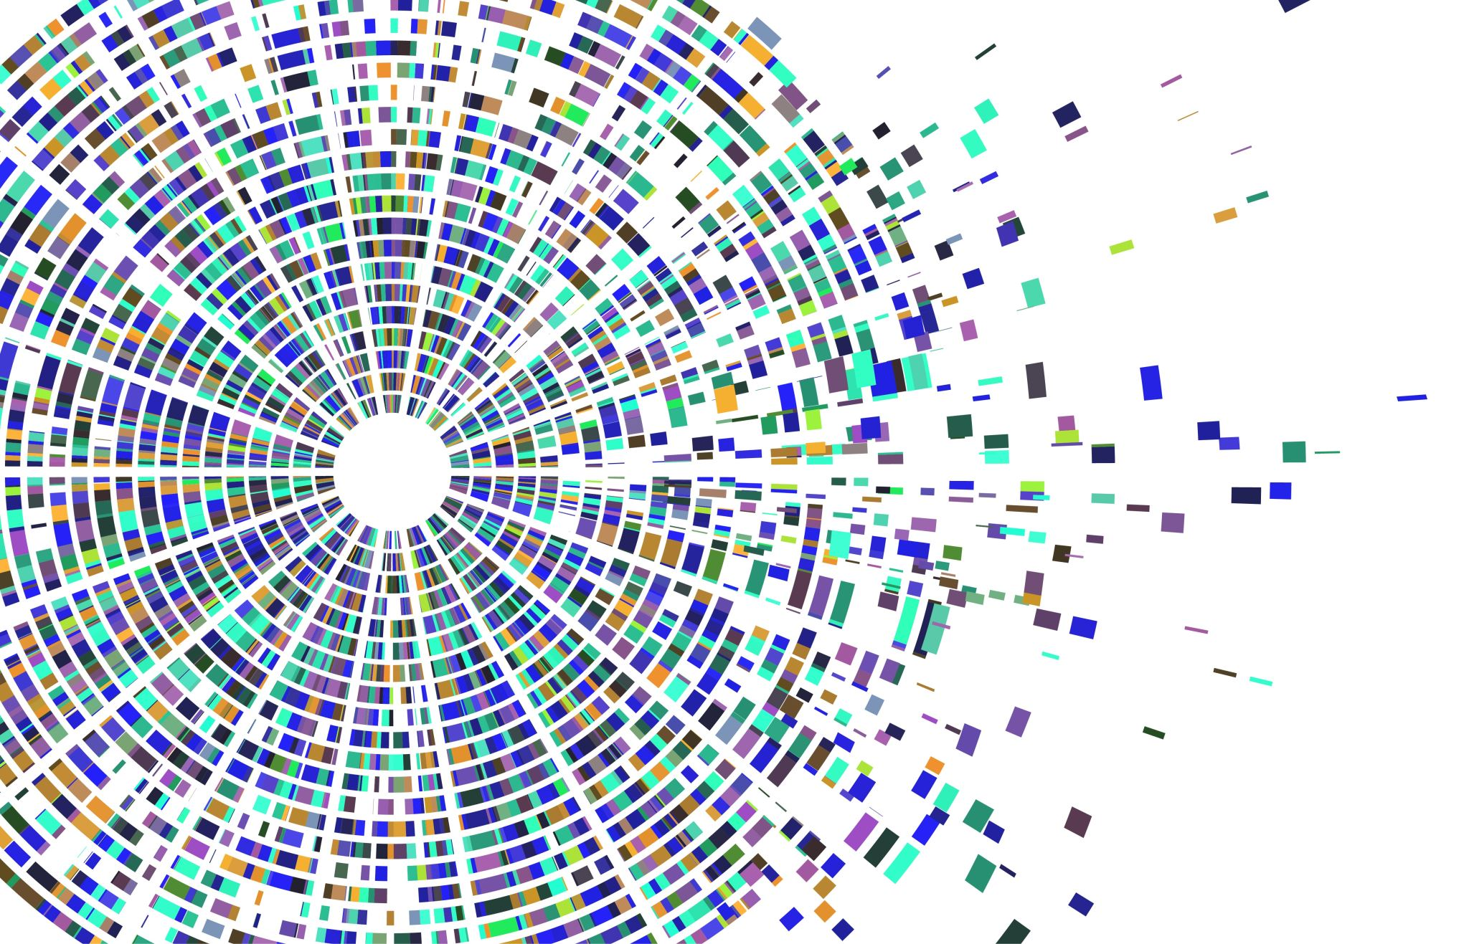
Exploratory Data Analysis (EDA)
Matplotlib, Seaborn and Word cloud libraries

Slide 4
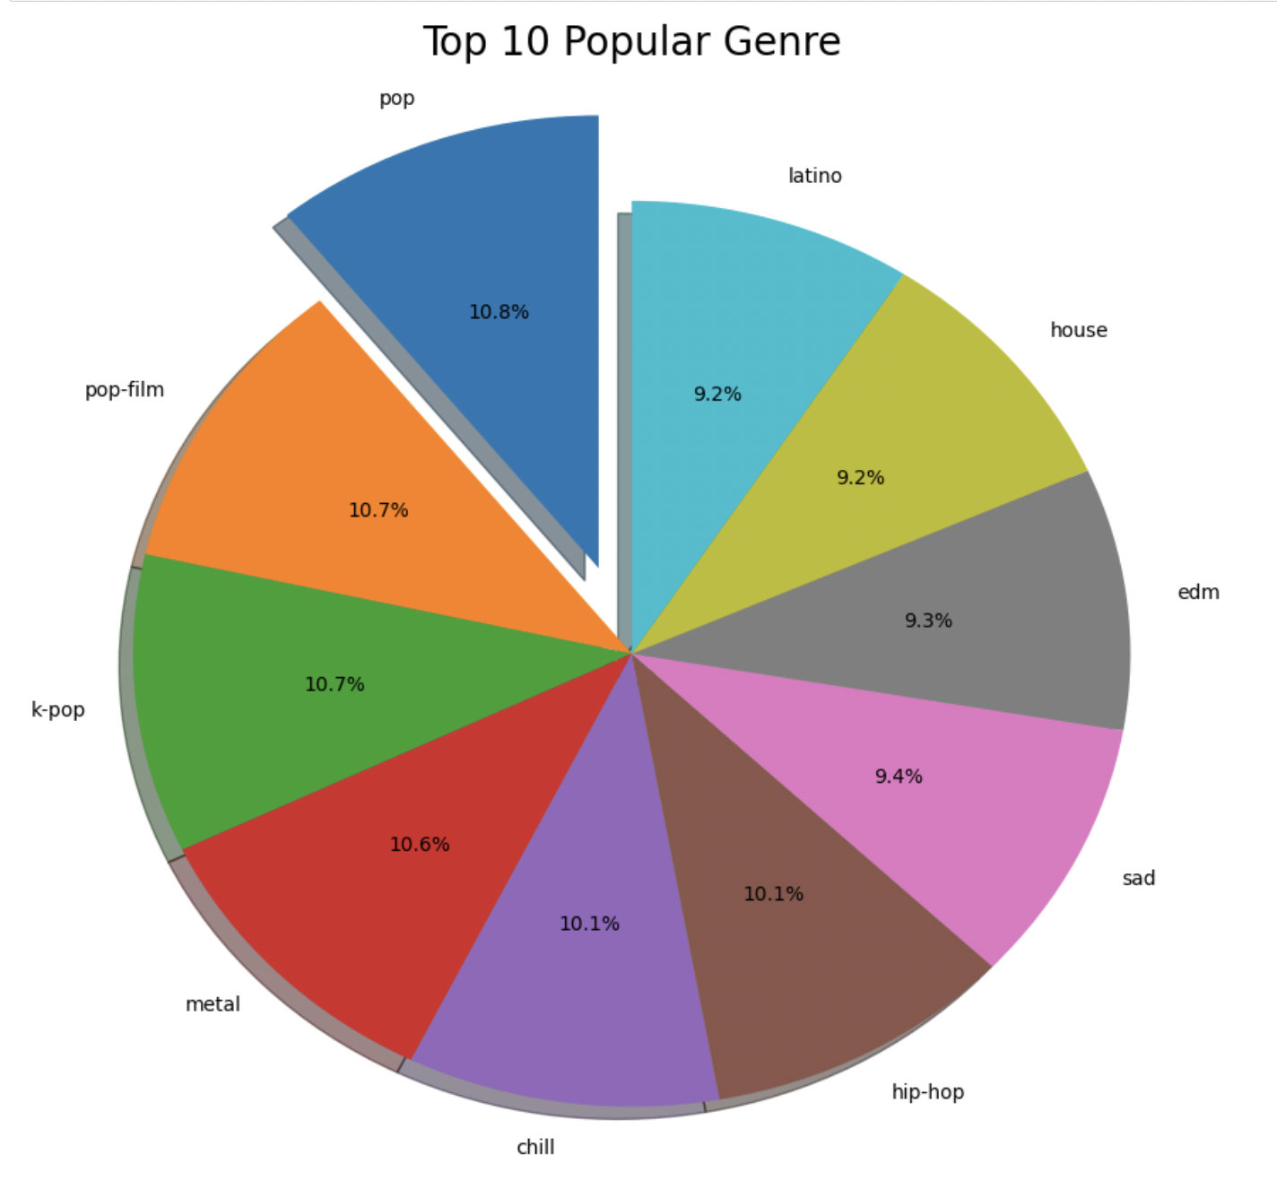
Top 10 popular genres
Genres | Popularity (0-100)
Pop | 67.95
Electro | 63.22
Dance | 62.18
House | 61.39
Soul | 61.26
Hip-hop | 61.21
Edm | 60.37
Pop-film | 59.21
Metal | 59.21
K-pop | 58.84

Slide 5
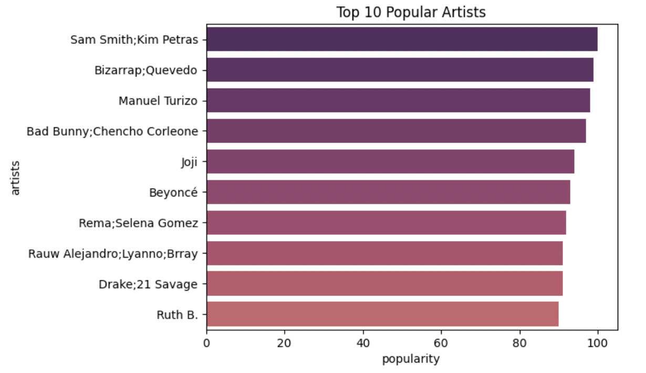
Top 10 popular artists
Artists | Popularity (0-100)
Sam Smith | 100.0
Bizarrap | 99.0
Manuel Turizo | 98.0
Bad Bunny | 97.0
Joji | 94.0
Beyonce | 93.0
Selena Gomez | 92.0
Rauw Alejandro | 91.0
Drake | 91.0
Ruth B. | 90.0

Slide 6
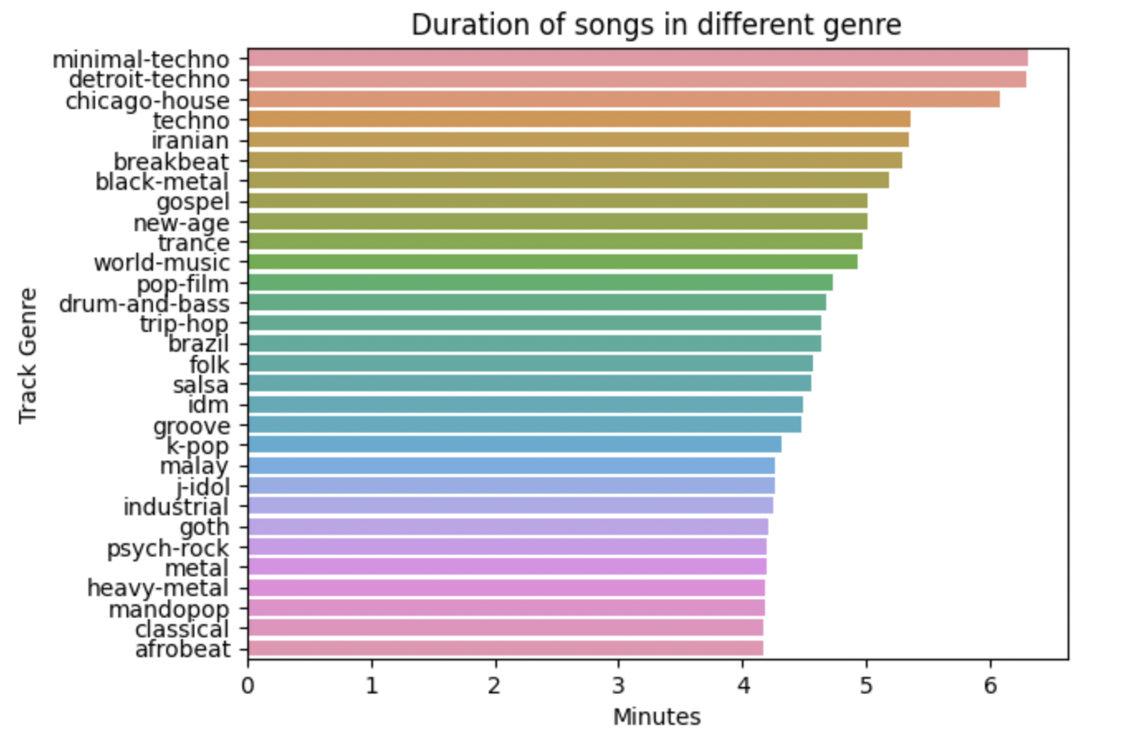
Duration of song in different genres
Genres | Duration (min)
Minimal-techno | 6.30
Detroit-techno | 6.29
Chicago-house | 6.08
Iranian | 6.01
Techno | 5.33
Breakbeat | 5.28
Black-metal | 5.18
New-age | 5.02
Gospel | 5.01
Trance | 4.95

Slide 7
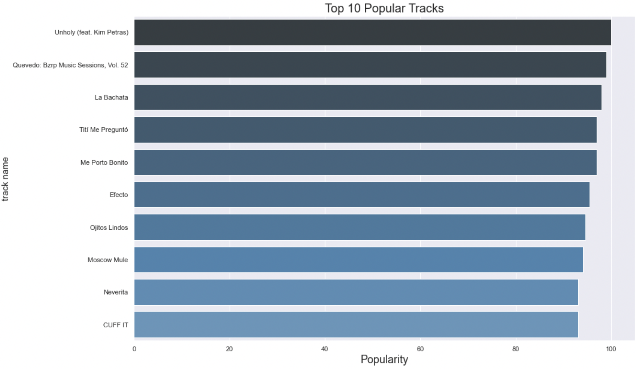
Top 10 popular tracks
Track Name | Popularity (0-100)
Unholy (Sam Smith ft. Kim Petras) | 100.0
Quevedo: Bzrp Music Sessions | 99.0
La Bachata | 98.0
Titi Me Pregunto | 97.0
Me Porto Bonito | 97.0
Efecto | 95.5
Ojitos Lindos | 94.5
Moscow Mule | 94.0
Neverita | 93.0
Cuff It | 93.0

Slide 8
Probabilities of popularity
Popularity>90
=
0.01%
Popularity>60
=
6.19%
Popularity>40
=
26.72%
Popularity>20
=
51.60%
Songs that are most played at current time fall under popular tracks rather than most played songs from all time.
Difficult to score high popularity based on Spotify’s algorithm.

Slide 9
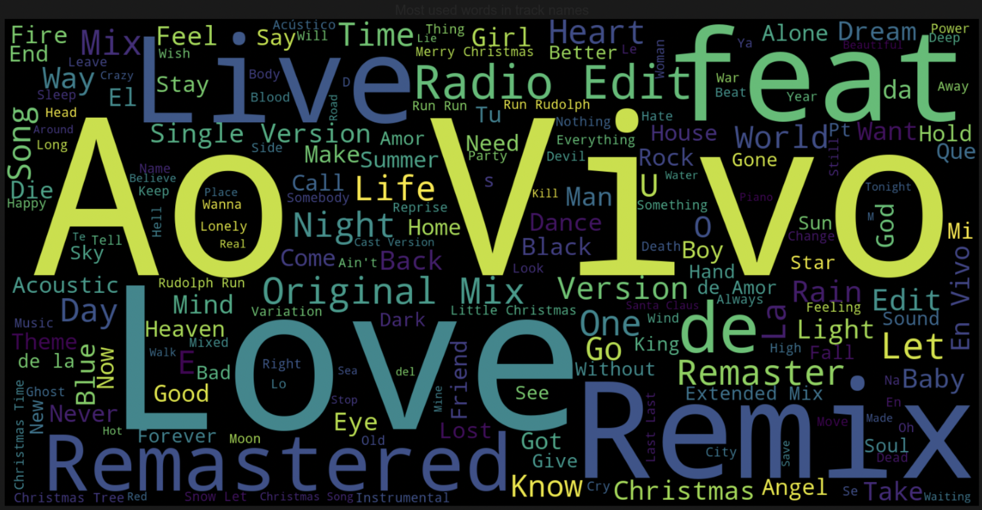
Word cloud of frequently used words in track names
Love
Live
Ao Vivo
Original Mix
Remix
Remastered
Feat
Radio Edit

Slide 10
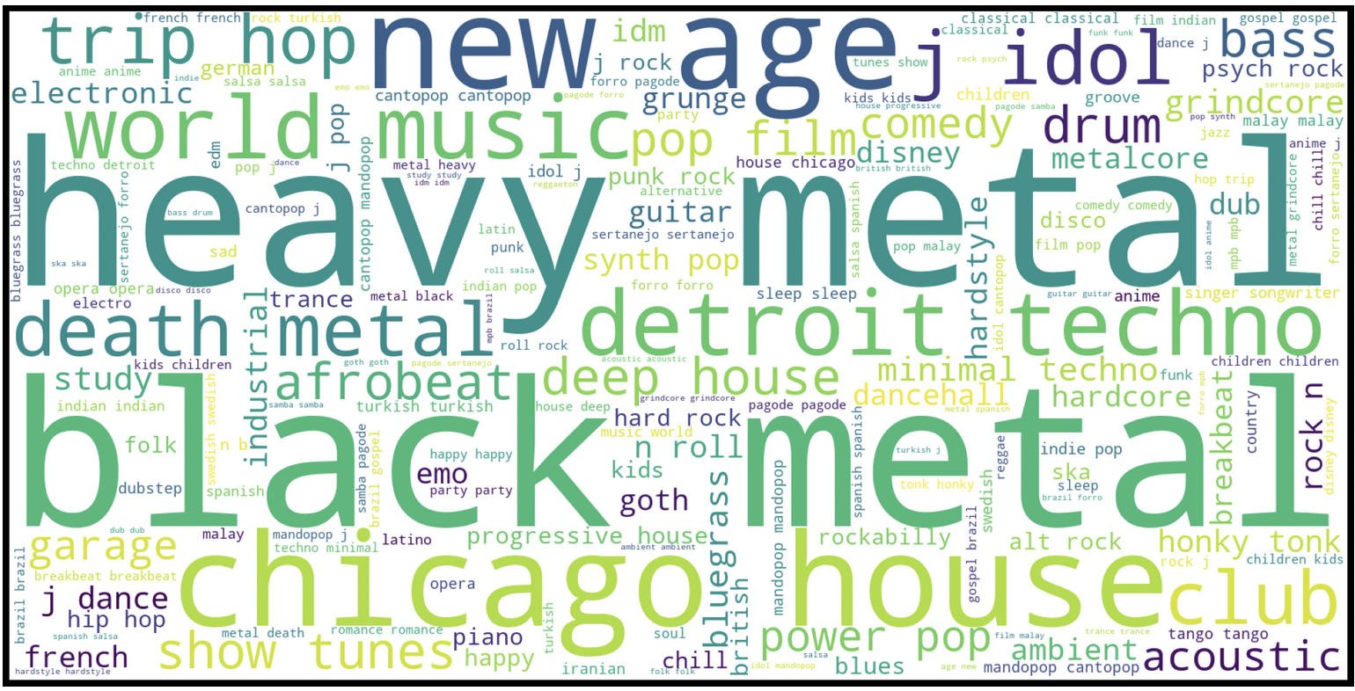
Word cloud of most repeated Genres
Heavy metal
Black Metal
New age
World music
Death metal
Detroit techno
Hard rock
Trip hop

Slide 11
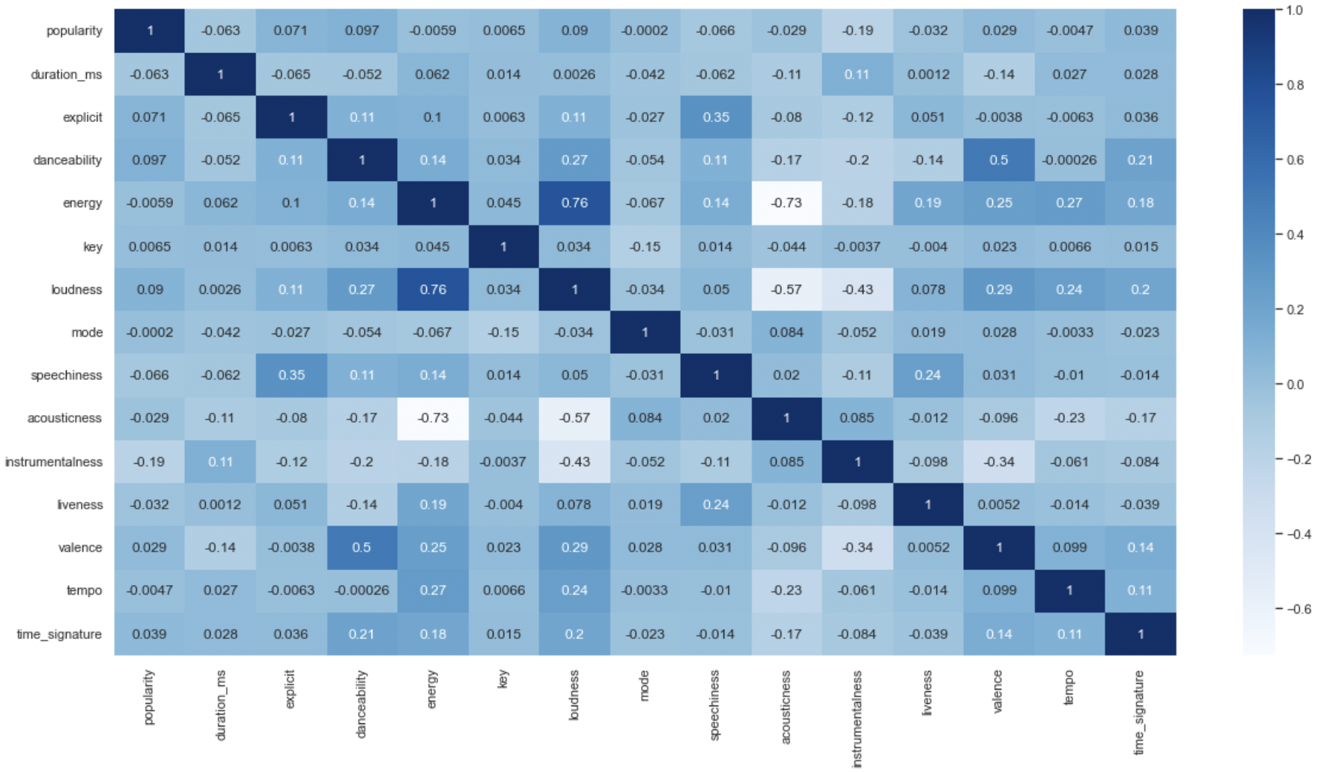
Correlation (heatmap)
Energy and loudness are positively correlated with each other because it makes sense for loud music to be energetic. Similarly, valence is also positively correlated with danceability because valence represents songs which are happy and cheerful.
Whereas, acousticness is negatively correlated with energy and loudness because acoustic songs are quiet and calm.

Slide 12
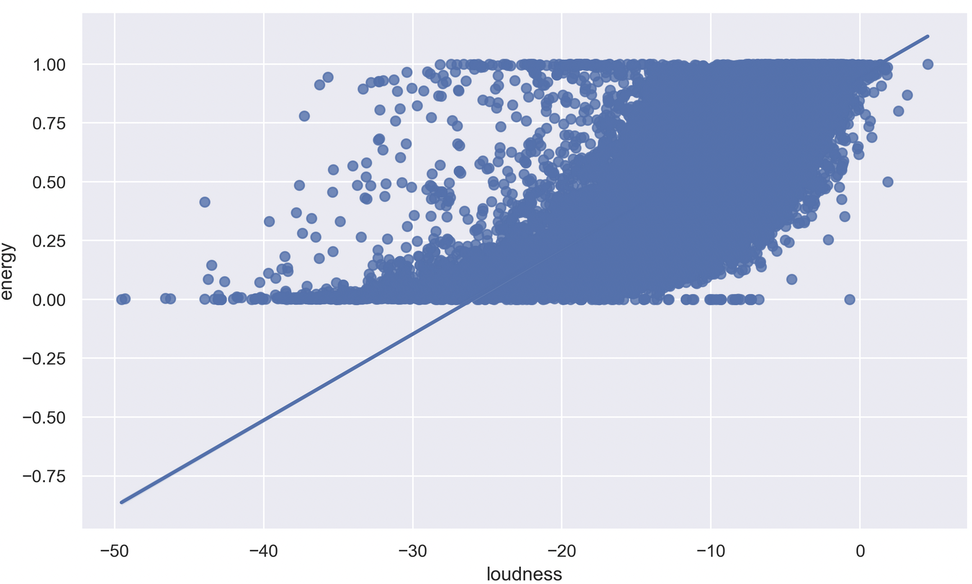
Correlation: Loudness vs energy
Loudness and energy correlated with each other at almost 45 degree which suggests that there is strong relation between a song being loud and energetic.

Slide 13
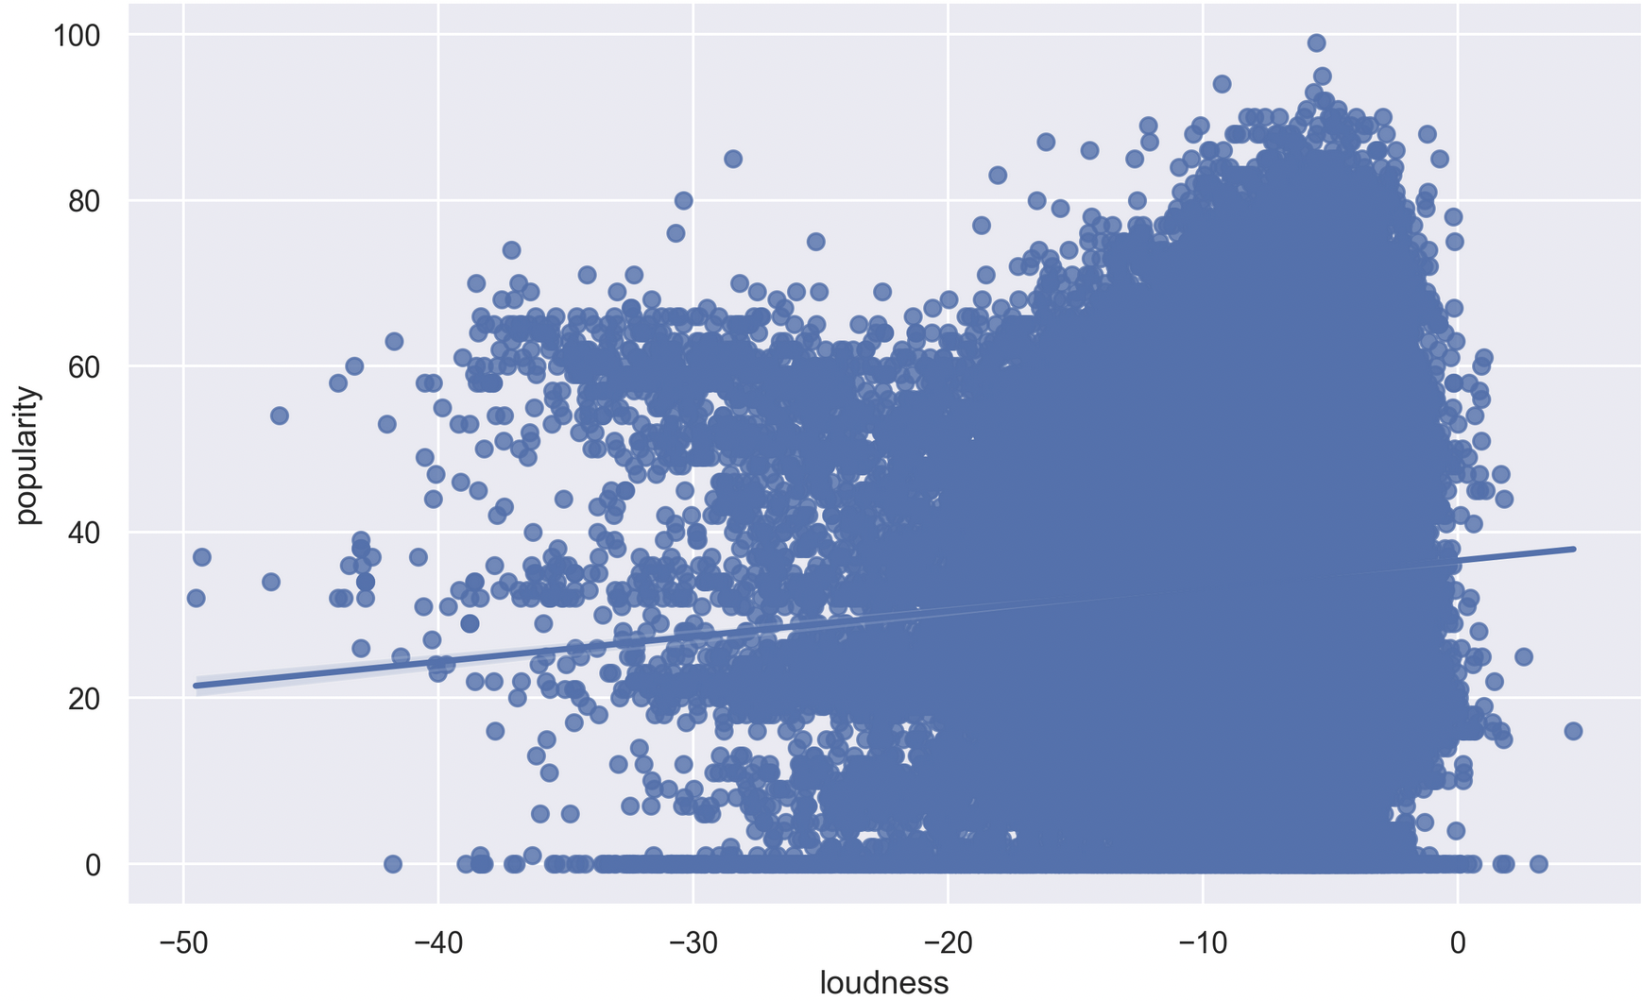
Correlation: Loudness vs popularity
With over 100,000 songs we can infer that there’s slight correlation between the music being and loud and popular.
Most of the loud music are popular compared to the ones that are less loud.

Slide 14
INITIAL Challenges with dataset
Domain knowledge
Work on limited set of features
Primary data vs Secondary Data

Slide 15
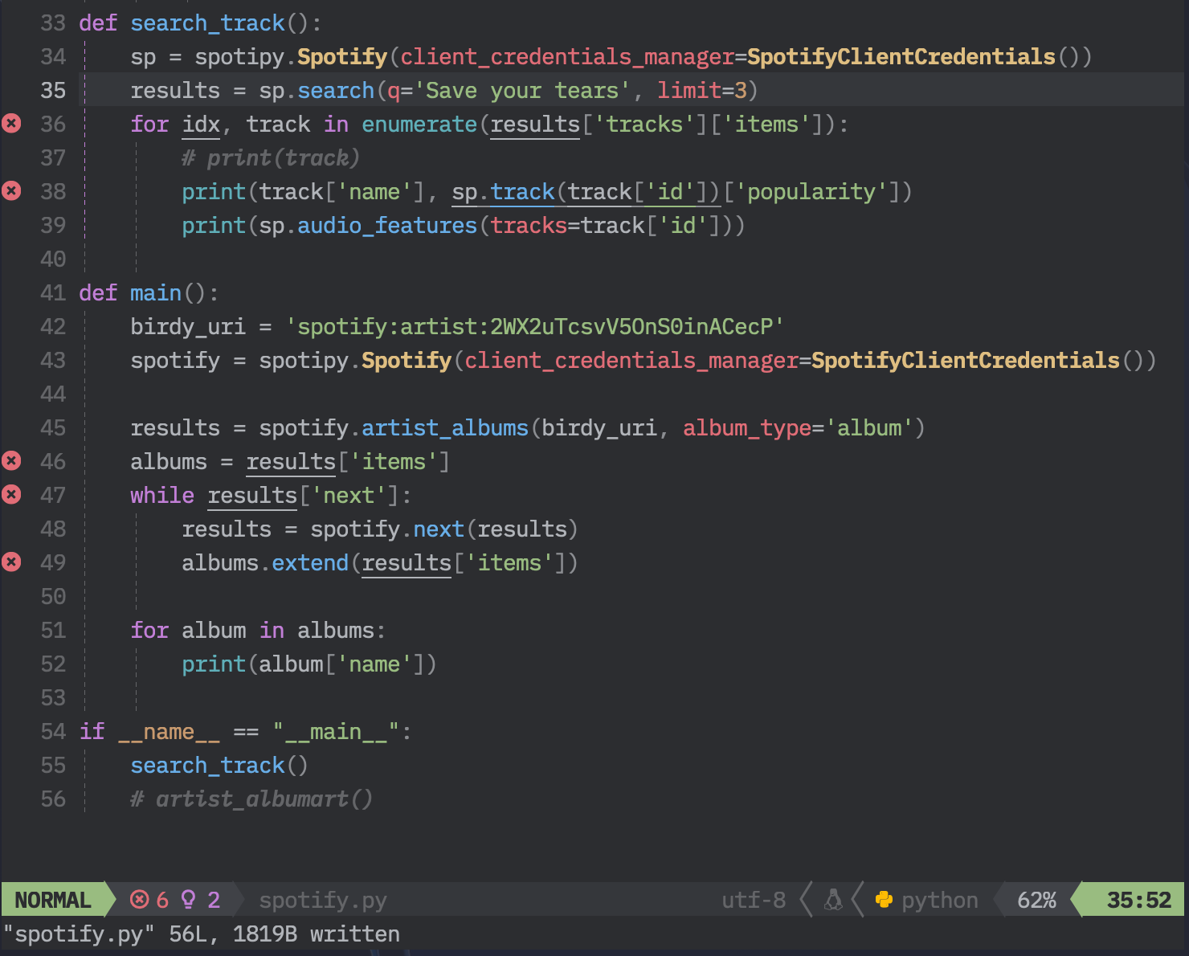
SPOTIFY web api
Get tracks, album, artists
Python package:
pip install spotipy

Slide 16
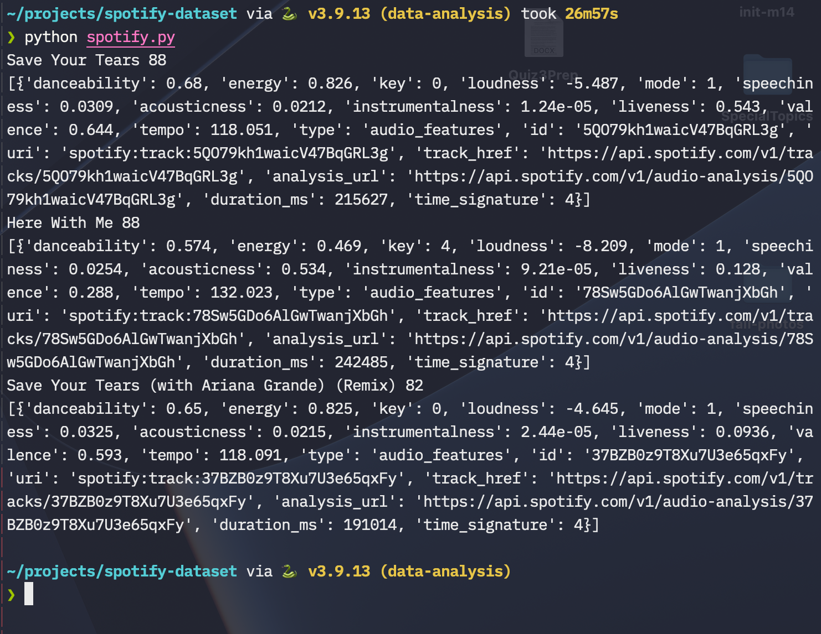

Slide 17

Audio Features
Acousticness
Speechiness
Loudness (Decibels)
Energy
Danceability
Valence (Cheerful, happy)

Slide 18
Prediction of the popularity (Based on the dataset)
“ The popularity is calculated by algorithm and is based, in the most part, on the total number of plays the track has had and how recent those plays are. Generally speaking, songs that are being played a lot now will have a higher popularity than songs that were played a lot in the past. Duplicate tracks (e.g. the same track from a single and an album) are rated independently. “ – Spotify WEB API Docs

Slide 19
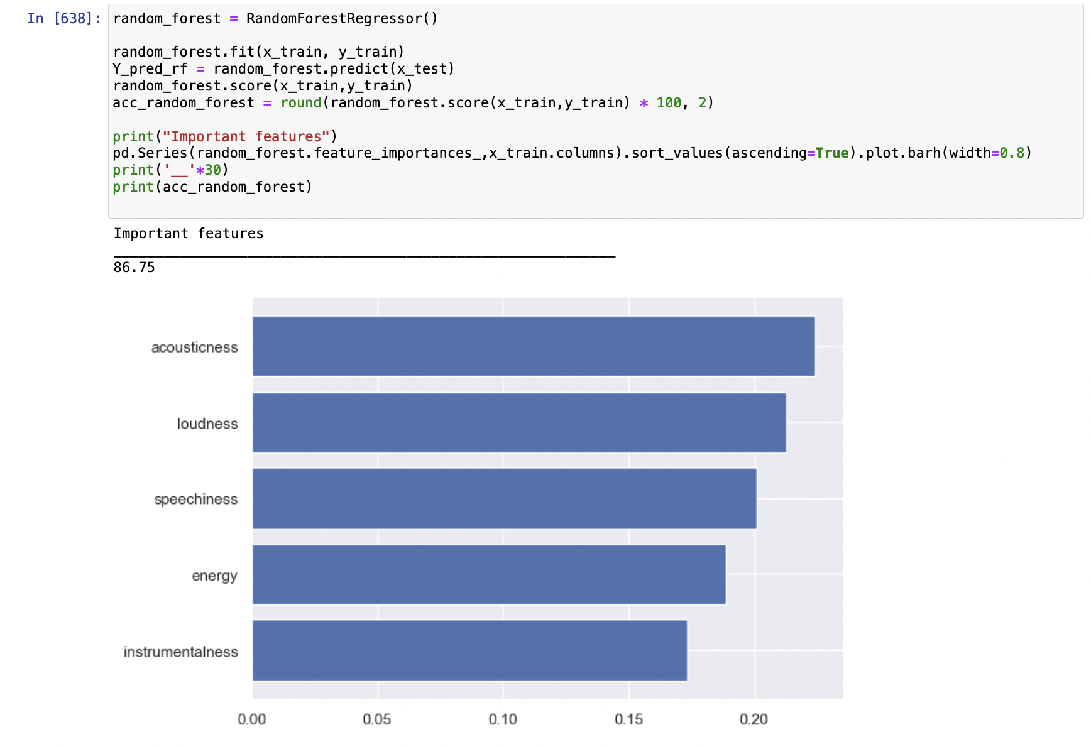
Feature selection
We tried different models and came up with the best score of important features at 86.75.
Acousticness, loudness, speechiness, energy and instrumentalness

Slide 20
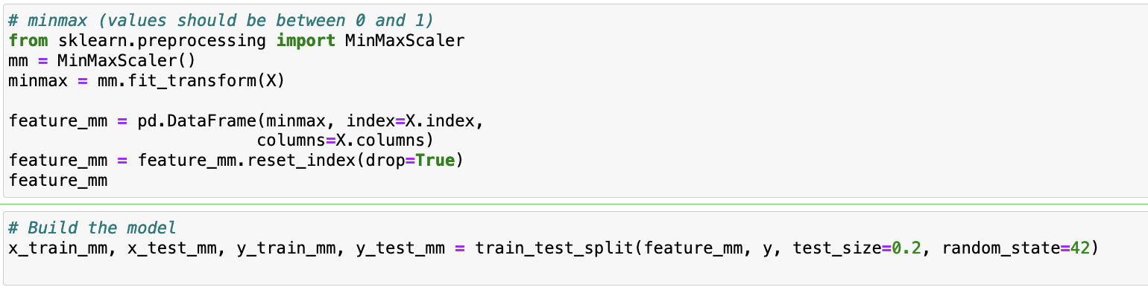
Train and test sets / Min Max scaler

Slide 21
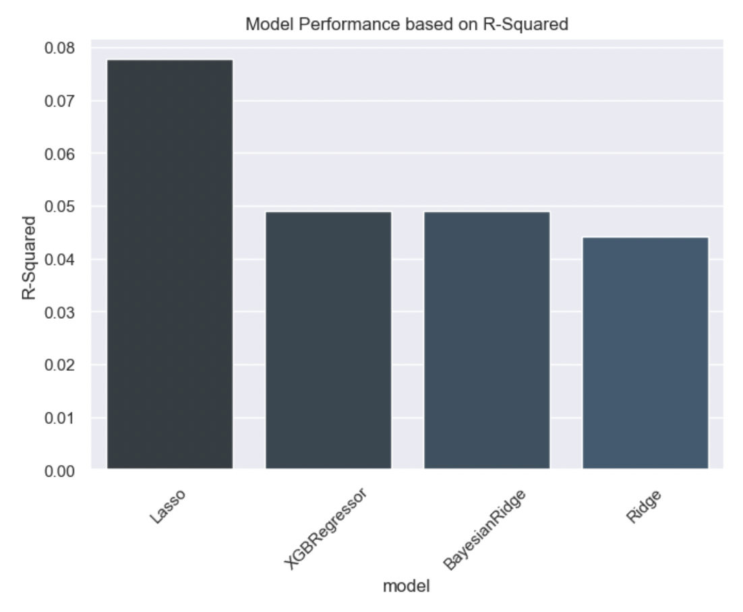
Model outcomes
We can see that even the well performing model, Lasso has relatively very low R-squared which suggests that even though some of the data points are correlated with popularity but can be problematic to precisely predict the value of popularity based on these correlated data points and from above R2 squared.

Slide 22
Learning Performance Metrics from Regression models
Predicting popularity is not only based on the audio features.
As mentioned in the spotify web api docs, different measures are carried out to calculate the popularity of a track
By now we had realized that there was too much variance in the dataset and with Low R-squared values we can expect of imprecise predictions.
Off we go to classifications now.

Slide 23
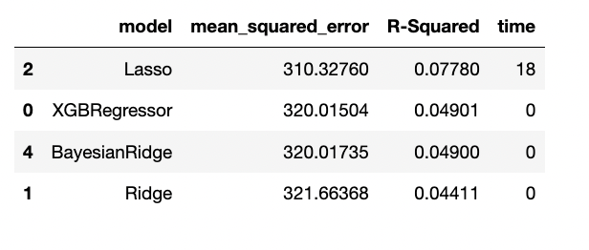
R square from different models

Slide 24
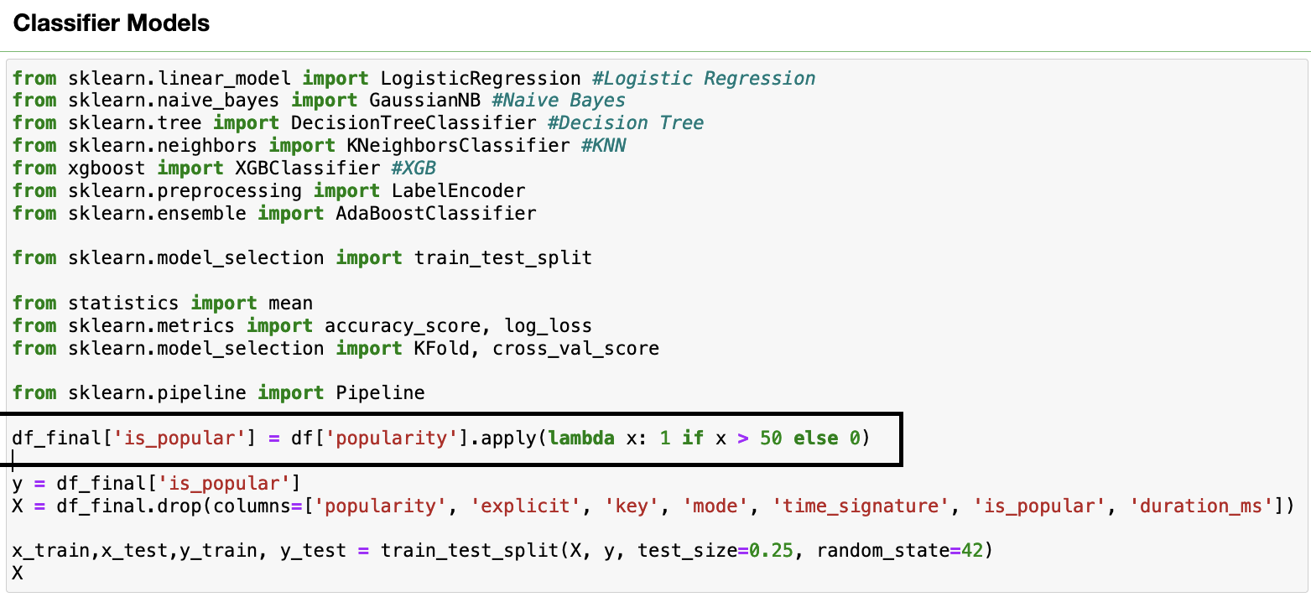
Classifier modeling – Binning Prediction

Slide 25
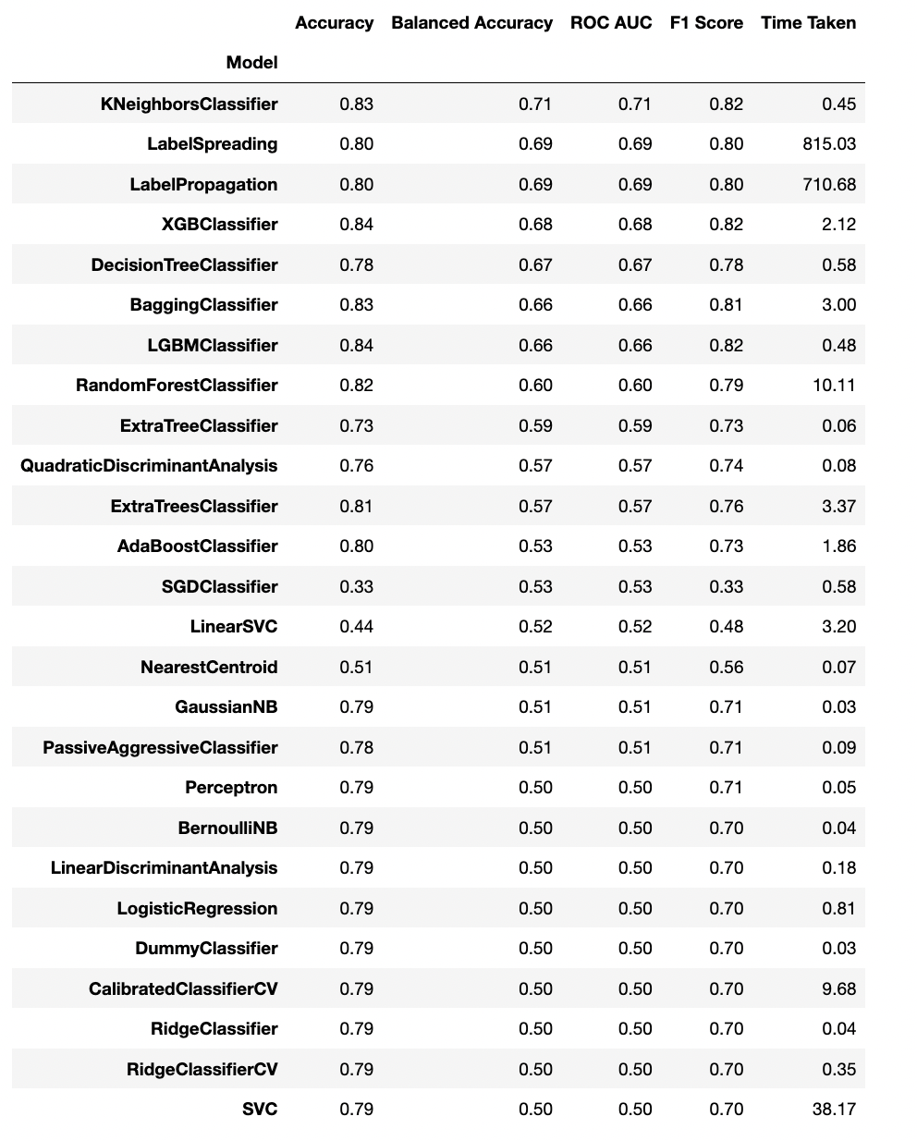
Model score from different classifiers

Slide 26
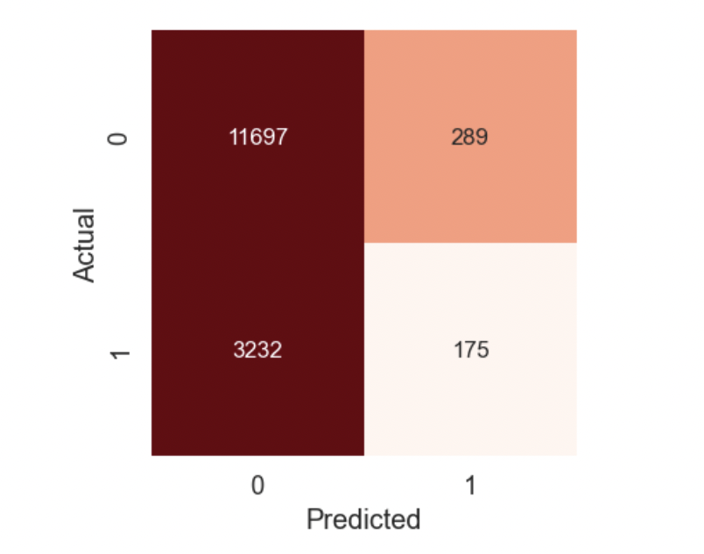
Confusion matrix
True negative and false negative is quite high but we got true negative on the higher side.
True positive and false positive although there are less occurrences, confusion matrix is showing the false negative on the higher side.

Slide 27
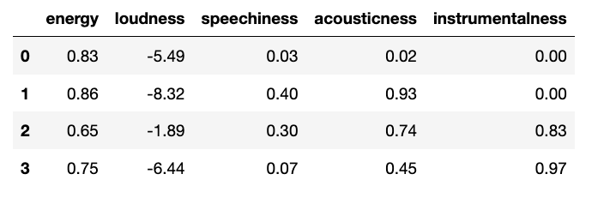
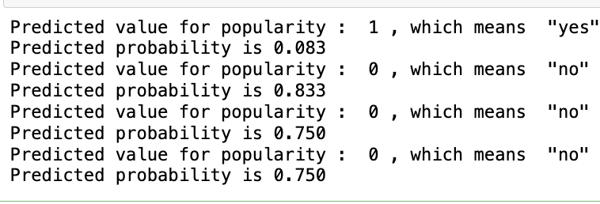
Out of sample prediction
From the analysis, it seems that for a song to be popular it is quite hard and not every feature of song can be easily integrated to make a song popular.

Slide 28
limitations
This dataset did not have date variable which restricted us from making analysis based on time-series, about how music is evolving with time.
Availability of many audio features made it quite difficult to choose right set of features.
Since this dataset is big and has a lot of rows it was at times very time consuming to run different models.

Slide 29
Learning, summary and prediction
The popularity of a song is influenced by the danceability, loudness and valence.
Pop music is most popular nowadays.
Minimal-techno genre has the longest track duration.
Sam Smith’s (ft. Kim Petras ) Unholy is the most popular track.
High energy dance songs and songs with duration of approximately 3 minutes are more likely to become popular.
Although regression models were not with good R2 scores and highly significant in terms of different metrics, but we learned that with every dataset comes a challenge to build better models and improve scores by applying different tuning to models.

Slide 30
Thank you

